Slide 1



Pedal Assist System For Electric Bike
Project Members:
Satish Kumar Mahaseth (42044)
Kushal Bhatta (42031)
Kiran Khatri(42042)
Project Supervisor:
Dr. Bishal Silwal
Asst. Prof., Dept. of EEE
Kathmandu University
28 March, 2024

Slide 2
Outline:
Background and Introduction
Problem Definition
Objectives of the Project
Literature Review
Project Methodology
Result and Analysis
Conclusion
Gantt Chart
References
Satish Mahaseth, Kiran Khatri, Kushal Bhatta
Department of Electrical and Electronics Engineering 2024

Slide 3
Background and Introduction:
Nepal relies heavily on petroleum for transportation.
Nepal has great potential for hydroelectric energy.
Electric vehicles offer potential benefits.
The combination of human effort with electric motor increases range and minimizes battery cost.
Pedal-assist electric bicycles can improve the viability of electric transportation in developing countries like Nepal.
Satish Mahaseth, Kiran Khatri, Kushal Bhatta
Department of Electrical and Electronics Engineering 2024

Slide 4
Background and Introduction:
Pedal assist electric bicycles contribute to several SDGs, including:
SDG 3: Good Health and Well-being
SDG 7: Affordable and Clean Energy
SDG 11: Sustainable Cities and Communities
SDG 13: Climate Action
Satish Mahaseth, Kiran Khatri, Kushal Bhatta
Department of Electrical and Electronics Engineering 2024

Slide 5
Problem Definition:
It helps to bridge the gap between the need for motorized transportation and the affordability of conventional motorcycles.
It helps to decrease the carbon footprint of vehicles.
Satish Mahaseth, Kiran Khatri, Kushal Bhatta
Department of Electrical and Electronics Engineering 2024

Slide 6
Objectives:
Primary objective
To design and develop a pedal-assist system for electric bicycles.
Secondary objectives
To investigate the effects of pedal assist on the performance of electric bicycles such as speed, range, and battery durability.
To test the pedal assist system under a variety of conditions such as different terrains, loads, and weather conditions.
Satish Mahaseth, Kiran Khatri, Kushal Bhatta
Department of Electrical and Electronics Engineering 2024

Slide 7
Literature Review:
In 1980 Eric and Joel Haberstock made the first pedal assist e-bike.
‘C- Tovar’ has Tested a pedal assist using a PMDC motor and a simple Arduino.
MC33887 have used having current rating of 2.5-5A and 5-28V voltage rating.
L. Alberto and his group have converted an old bicycle into a Hybrid.
Where, Hub motor, lithium-ion battery, and Gyroscope(MUP-6050 GY-521) have been used.
A. Petrillo and his group have made a pedal cycle to pedal assist using magnetic discs, and a cadence sensor.
Satish Mahaseth,Kiran Khatri, Kushal Bhatta
Department of Electrical and Electronics Engineering 2024

Slide 8
Project Description:
The pedal assist system combines inputs from cadence sensors and assists level switches, central controller process to give correct output for the motor.
With electric assistance harmonizing with the rider's pedaling, making uphill rides easier and extending the range.
The central main controller processes various inputs, including battery temperature and brake data, to generate control signals regulating the speed controller's operation.
The system continuously monitors critical parameters like brake engagement and battery temperature, interrupting motor power if necessary, ensuring rider safety and operational dependability.
Satish Mahaseth,Kiran Khatri, Kushal Bhatta
Department of Electrical and Electronics Engineering 2024

Slide 9
Block Diagram:
Throttle
Gyroscope
Battery Voltage & Temperature
Supply
Pedal Assist Switch
Control unit
Speed Controller
BLDC Motor
Braking Unit
Cadence Sensor
Hall Sensor
Satish Mahaseth, Kiran Khatri, Kushal Bhatta
Department of Electrical and Electronics Engineering 2024

Slide 10
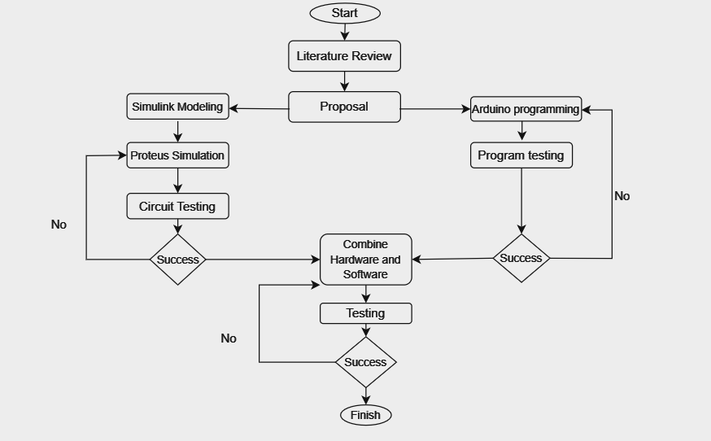
Project Methodology:
Figure: Workflow Diagram
Satish Mahaseth, Kiran Khatri, Kushal Bhatta
Department of Electrical and Electronics Engineering 2024

Slide 11
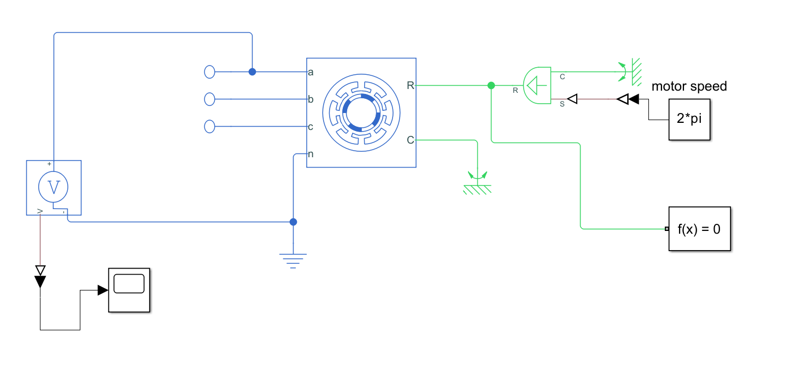
Result And Analysis:
The control mechanism of BLDC has been found out with the help of the back emf of the stator.
Fig: MATLAB simulation of BLDC back EMF
Satish Mahaseth, Kiran Khatri, Kushal Bhatta
Department of Electrical and Electronics Engineering 2024

Slide 12
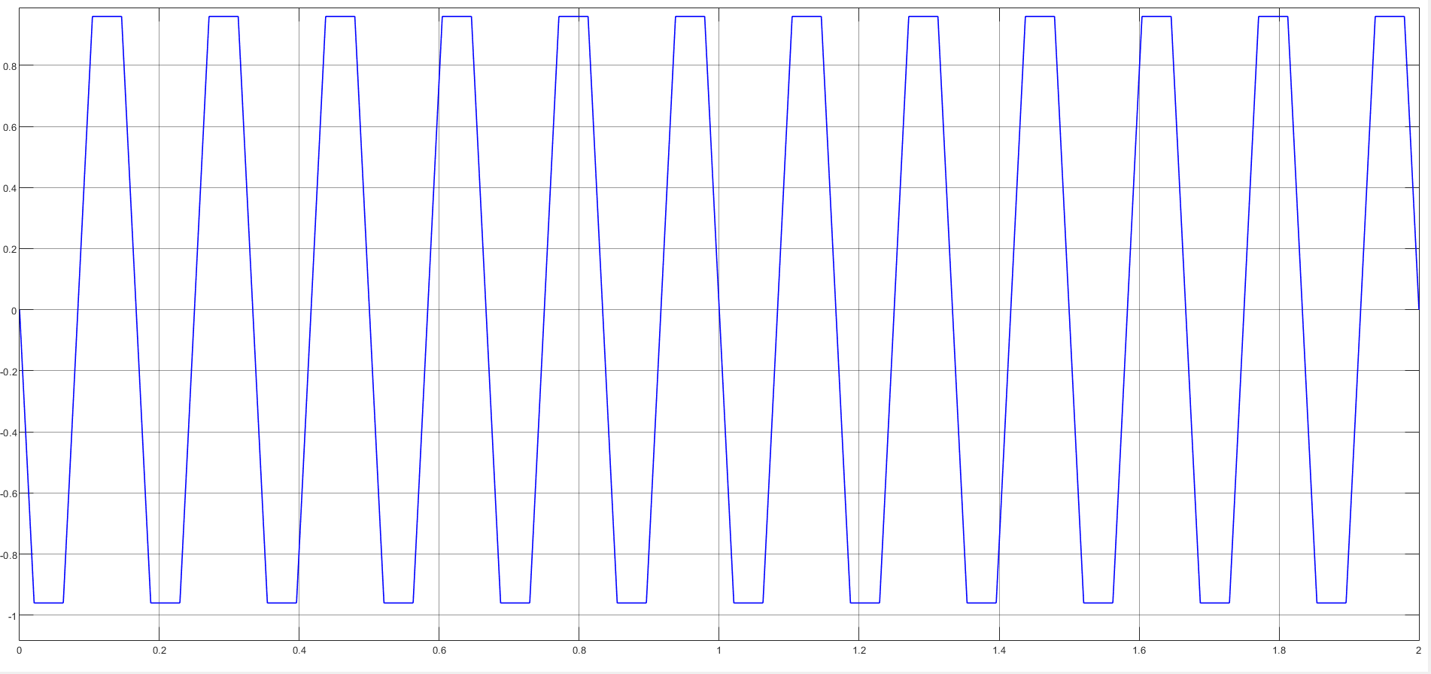
Result And Analysis:
The control mechanism of BLDC has been found out with the help of the back emf of the stator.
Fig: MATLAB simulation of BLDC back EMF
Fig: Trapezoidal signal of back EMF of BLDC
Satish Mahaseth, Kiran Khatri, Kushal Bhatta
Department of Electrical and Electronics Engineering 2024

Slide 13
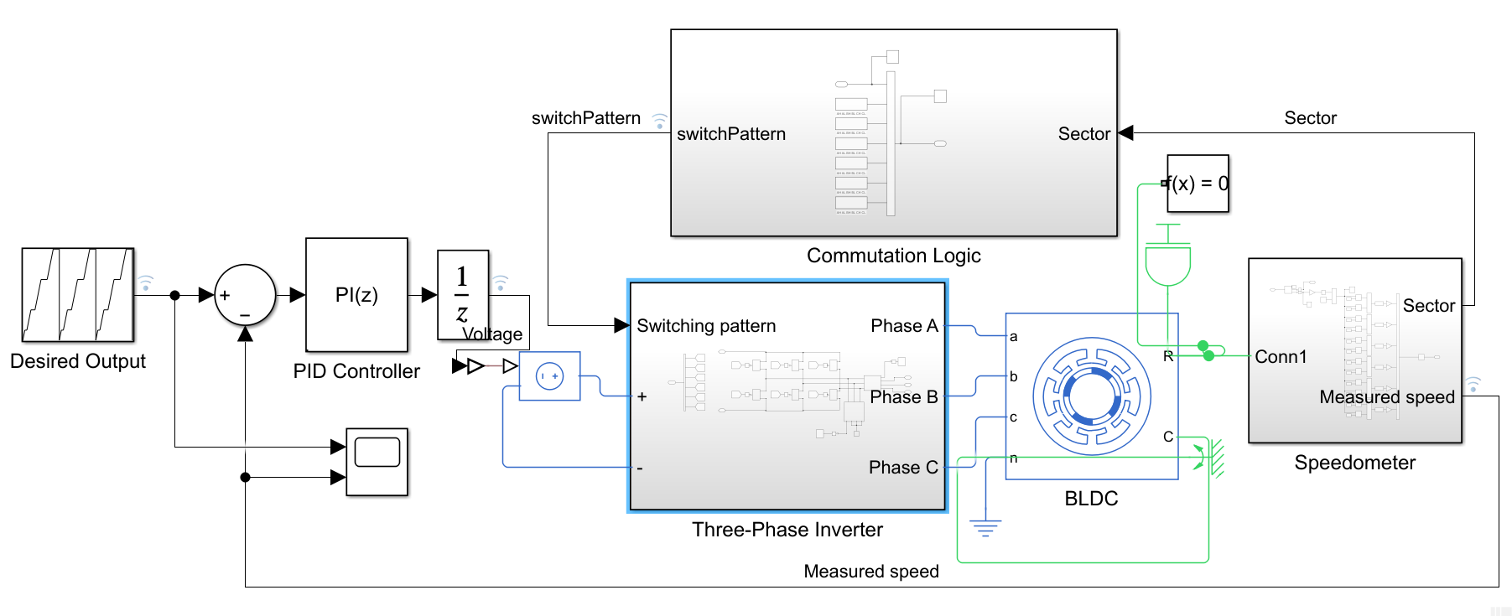
Result And Analysis:
The simulation of the Speed controller of BLDC has been done in Simulink to check all parameters in different conditions.
Fig: overall BLDC motor controller modeling
Satish Mahaseth, Kiran Khatri, Kushal Bhatta
Department of Electrical and Electronics Engineering 2023

Slide 14
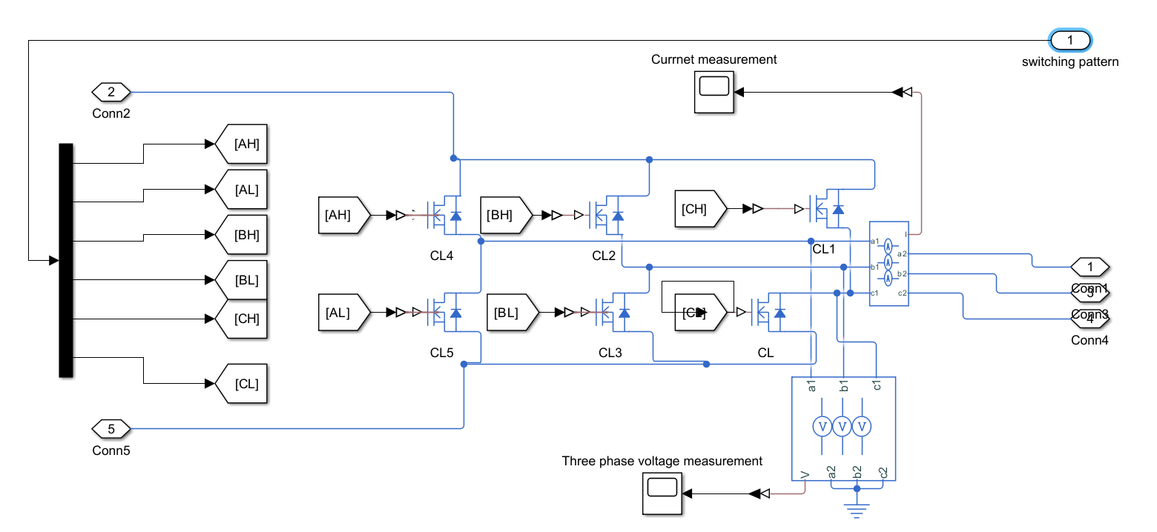
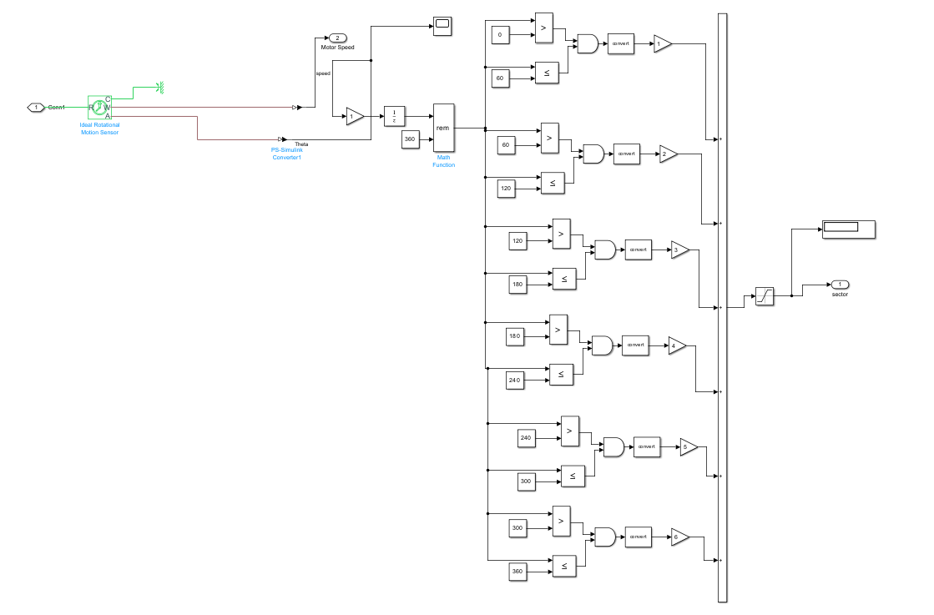
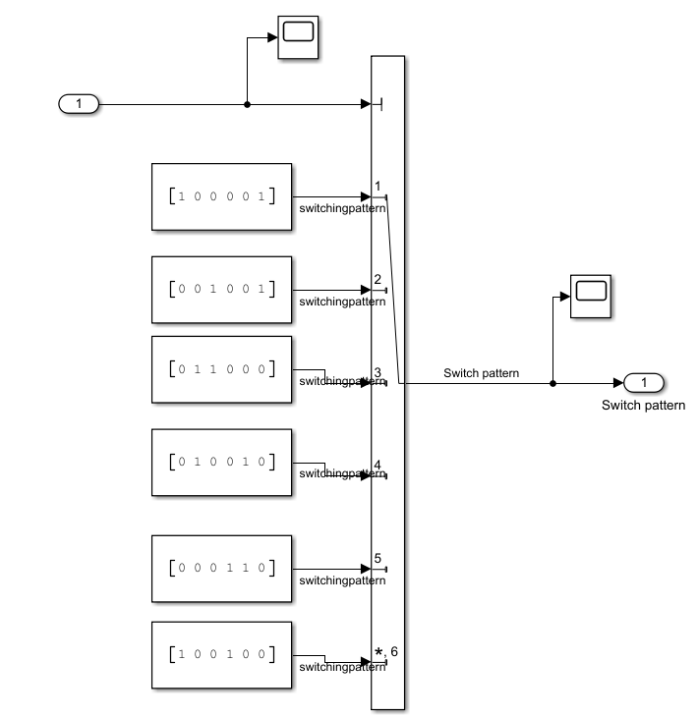
Result And Analysis:
Modeling of the three-phase inverter, sensor, and trapezoidal switching pattern has been done.
Fig: Modeling of three-phase inverter
Fig: Hall effect position sensor
Fig: Switching pattern of MOSFET.
Satish Mahaseth, Kiran Khatri, Kushal Bhatta
Department of Electrical and Electronics Engineering 2023

Slide 15
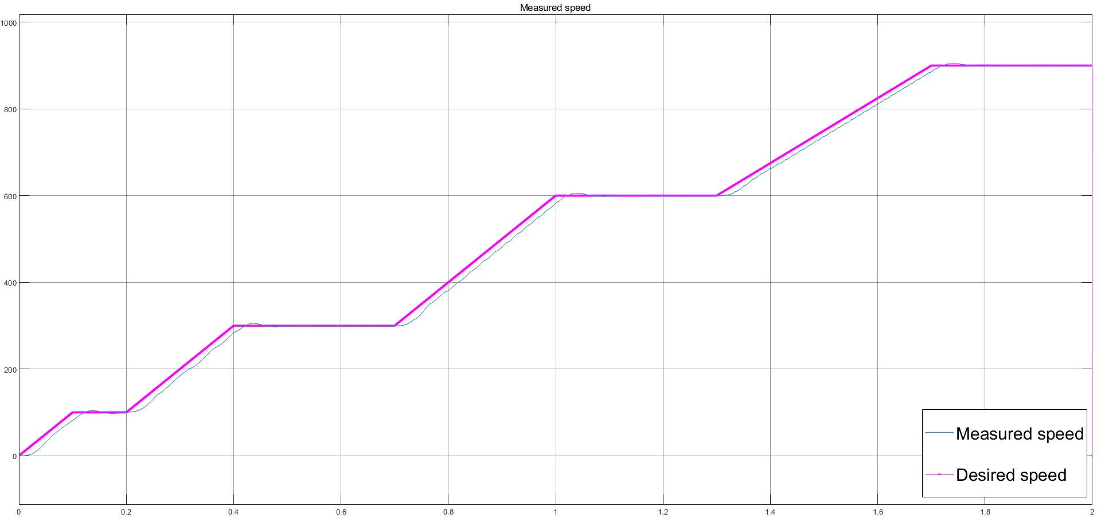
Result And Analysis:
Satish Mahaseth, Kiran Khatri, Kushal Bhatta
Department of Electrical and Electronics Engineering 2024

Slide 16
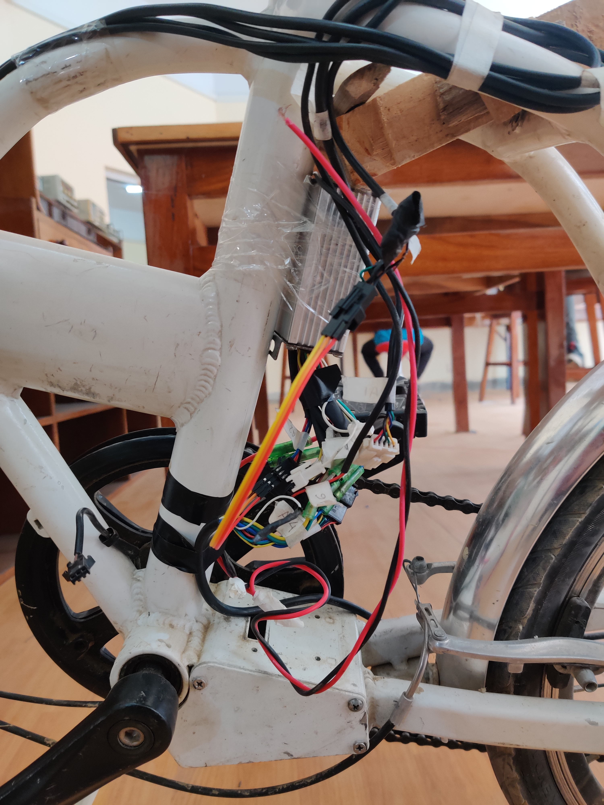
Result And Analysis:
Installation of motor controller
Motor Controller
Satish Mahaseth, Kiran Khatri, Kushal Bhatta
Department of Electrical and Electronics Engineering 2024

Slide 17
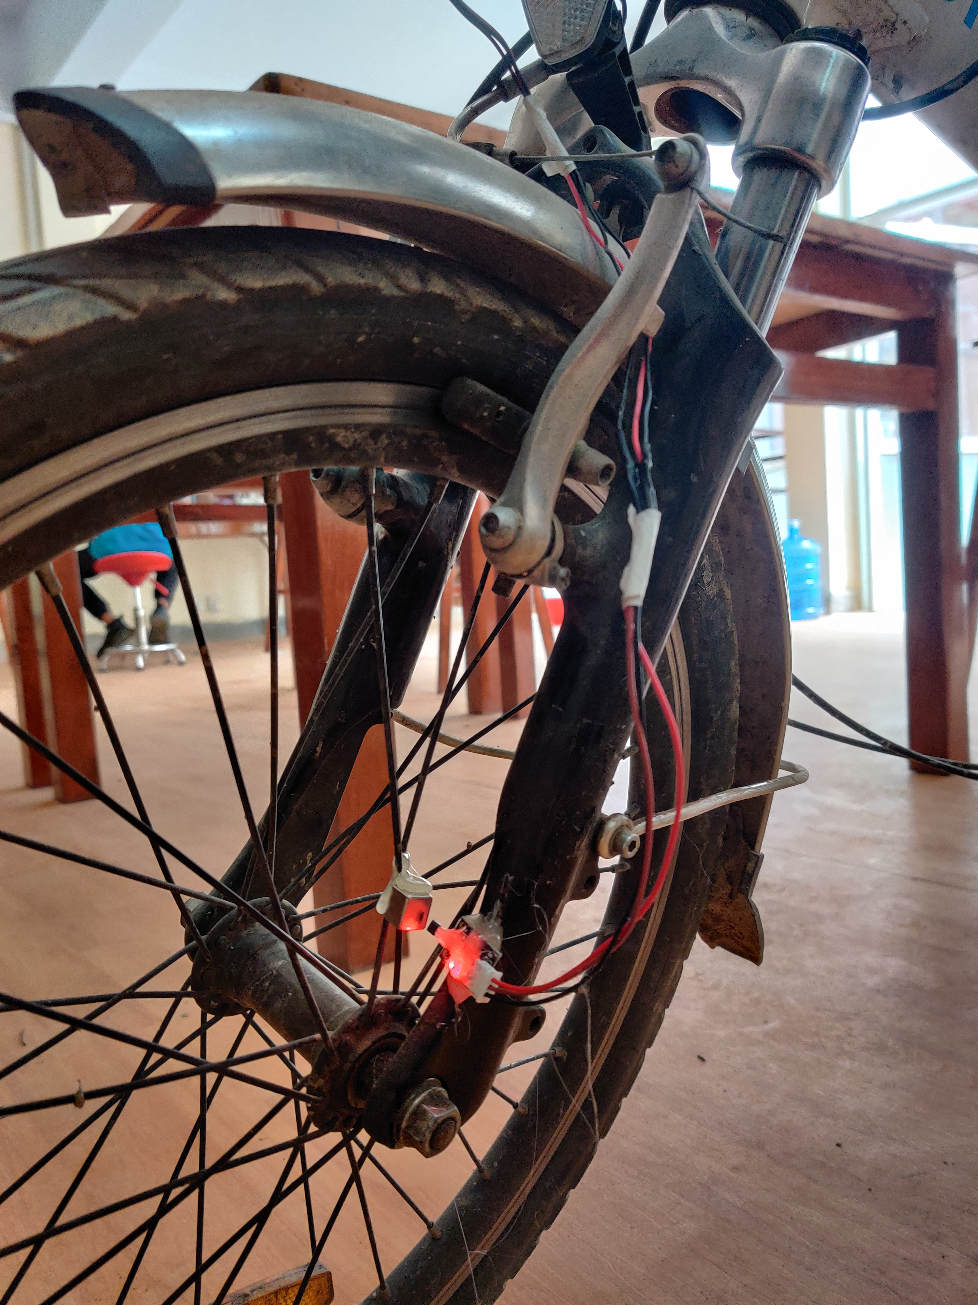
Result And Analysis:
Speedometer
Magnet
Hall Sensor
Satish Mahaseth, Kiran Khatri, Kushal Bhatta
Department of Electrical and Electronics Engineering 2024

Slide 18
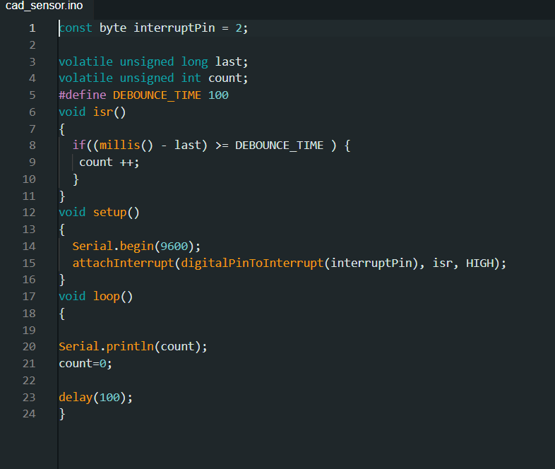

Result And Analysis:
Speed of the pedal has been determined with the help of hall effect sensor and Arduino program.
Fig: Arduino program for measuring pedal speed
Fig: Output speed of the pedal from Arduino code
Satish Mahaseth, Kiran Khatri, Kushal Bhatta
Department of Electrical and Electronics Engineering 2024

Slide 19

Result And Analysis:
Implementation of FreeRTOS for multi threading.
Advantage of using FreeRTOS
Multitasking
Task scheduling
Resource Management
Interrupt Handling
Fig: Arduino program for FreeRTOS
Satish Mahaseth, Kiran Khatri, Kushal Bhatta
Department of Electrical and Electronics Engineering 2024

Slide 20
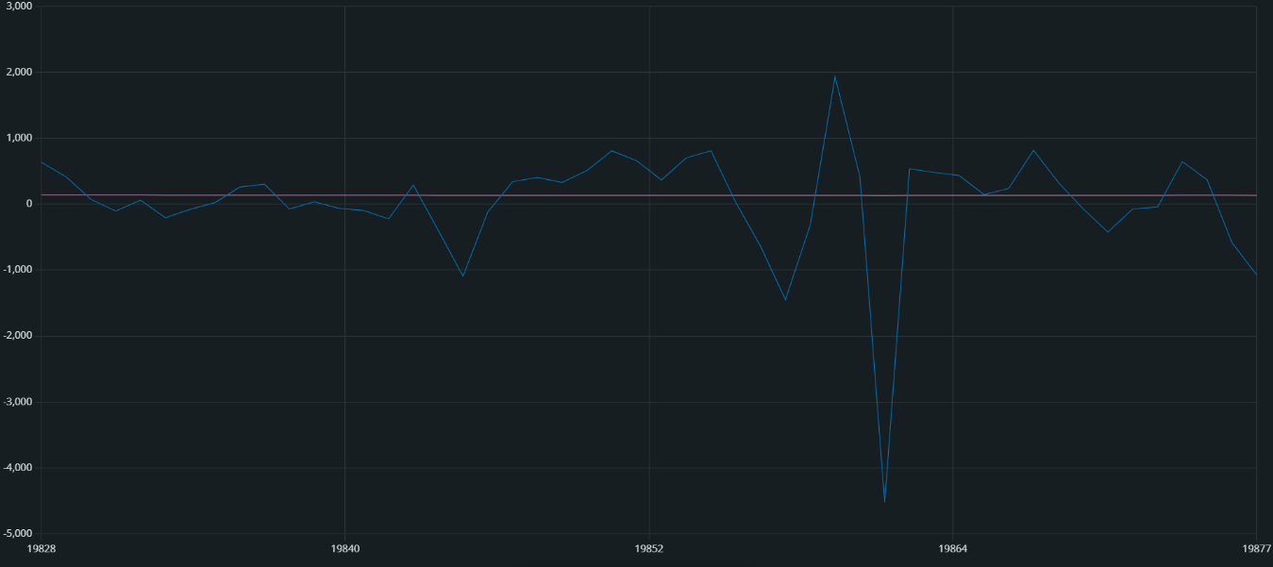
Result And Analysis:
Kalman Approximation
Without Kalman Approximation
With Kalman Approximation
Satish Mahaseth, Kiran Khatri, Kushal Bhatta
Department of Electrical and Electronics Engineering 2024

Slide 21
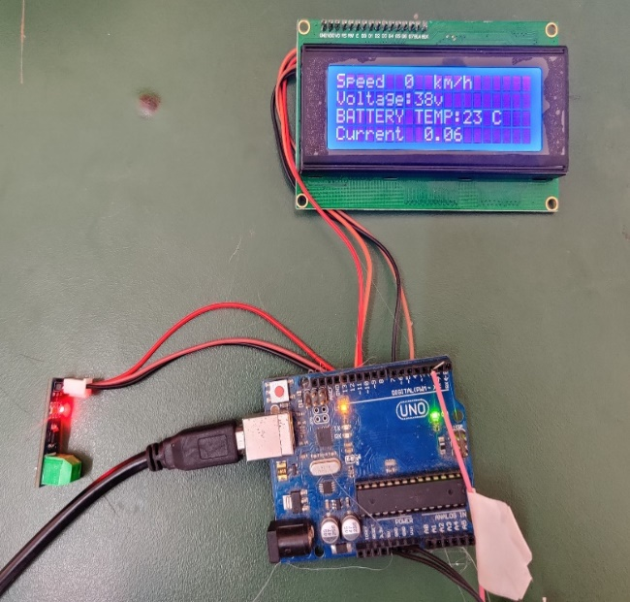
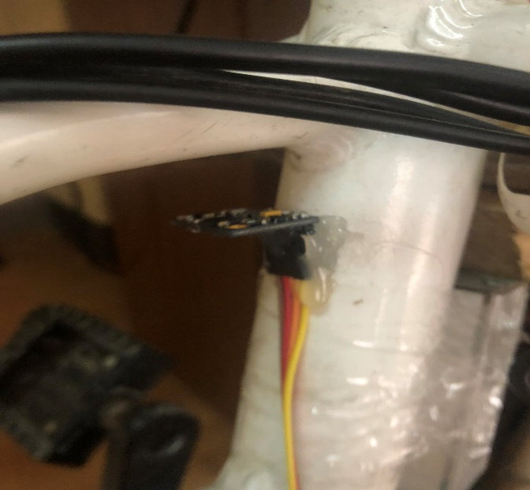
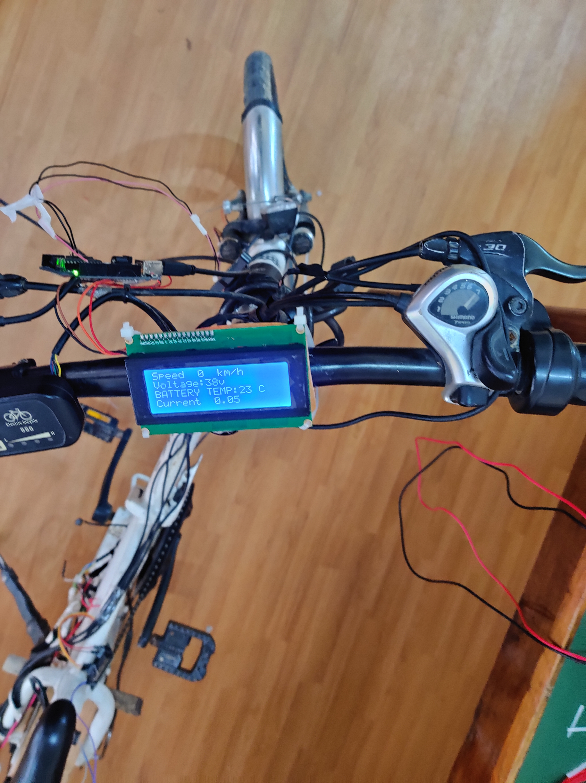
Result And Analysis:
Display, Current Sensor and Gyroscope
Current Sensor
Display
Gyroscope
Satish Mahaseth, Kiran Khatri, Kushal Bhatta
Department of Electrical and Electronics Engineering 2024

Slide 22
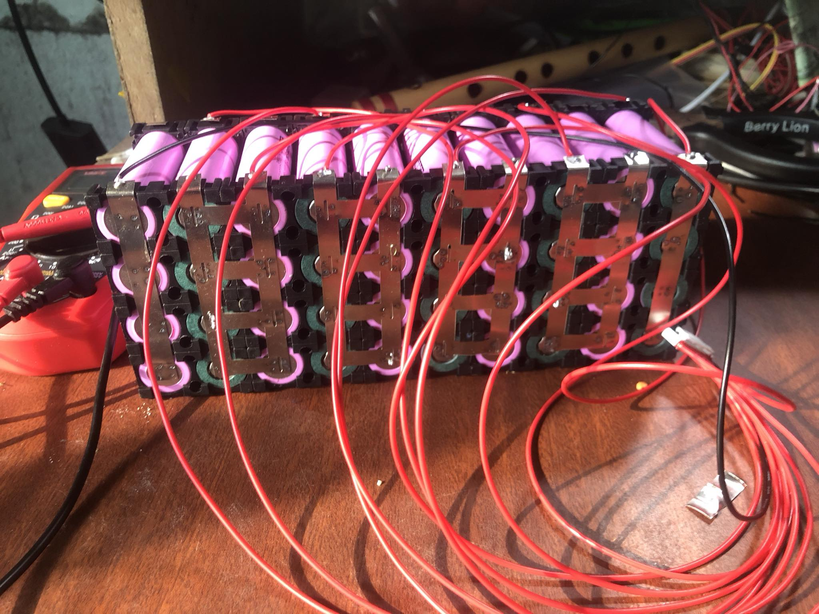
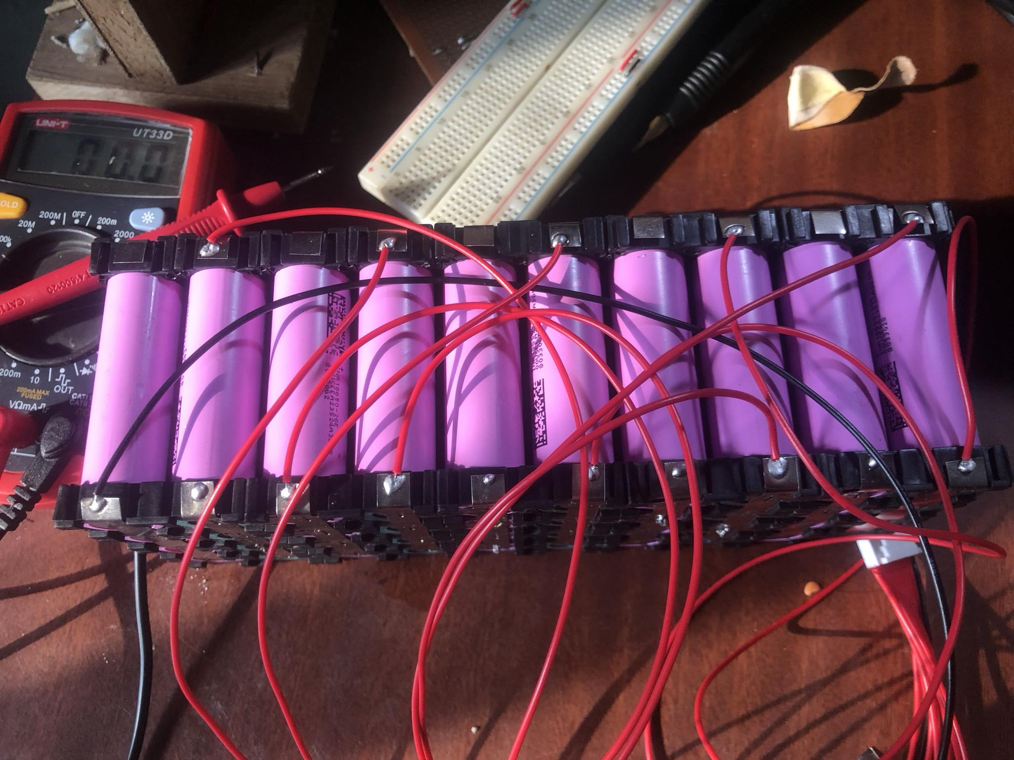
Result And Analysis:
36v li-ion battery pack development with 10s BMS
Satish Mahaseth, Kiran Khatri, Kushal Bhatta
Department of Electrical and Electronics Engineering 2024

Slide 23
Problem Encountered:
Reed switch, which is a part of the cadence sensor has the problem of bouncing effect so, we have to use the hall effect sensor.
Line-by-line execution of the program on the microcontroller makes the whole system slow so, to make the program responsive we have implemented an interrupt signal from the cadence sensor.
Availability of voltage source for testing motor is less around the University premise.
The connector available in the commercial controller doesn’t match with other system.
36V li-ion battery was unavailable so we made a battery pack with li-ion cells.
Satish Mahaseth, Kiran Khatri, Kushal Bhatta
Department of Electrical and Electronics Engineering 2024

Slide 24
Conclusion:
This project focused on the development of a pedal assist system for e-bikes, with particular emphasis on the simulation of the speed controller and the implementation of the cadence sensor with Kalman approximation. This increases e-bike's speed based on the rider's pedal input with higher accuracy.
Furthermore, the integration Gyroscope and accelerometer into the system has been completed, providing a crucial element for accurate pedal assistance. This ensures a responsive and intuitive experience for the rider, aligning the electric assistance with their pedaling rhythm effectively.
Ultimately this project boosts rider experience by providing more electric power in uphill and less electric power in downhill that increases efficiency of the battery and range of the bike.
Satish Mahaseth, Kiran Khatri, Kushal Bhatta
Department of Electrical and Electronics Engineering 2024

Slide 25
Gantt Chart:
S. N | Month | Aug | Sep | Oct | Nov | Dec | Jan | Feb | Mar
1. | Project Selection
2. | Literature Review
3. | Component Selection
4. | Proposal Submission
5. | Proposal Defense
6. | Simulation & Hardware
7. | Midterm Presentation
8. | Assemble & Testing
9. | Complete Project
10. | Final Presentation
Index
y | Task Completed
 | Task Remaining

Slide 26
References
[1] C. Tovar, “Electric Bicycle Design Final Project Work,” 2008.
[2] P. André Guerreiro Cavaco, L. Alberto Gonçalves de Sousa João Manuel Pereira Dias, J. Orlando Marques Gameiro Folgado Supervisor, and L. Alberto Gonçalves de Sousa, “Project of an electrically assisted bicycle adapted to the urban mobility Mechanical Engineering Examination Committee,” 2016.
[3] A. Petrillo, S. Mellino, F. De Felice, and I. Scudo, “Design of a Sustainable Electric PedalAssisted Bike: A Life Cycle Assessment Application in Italy.” [Online]. Available: www.intechopen.com
[4] A. Karthi, N. Afridhin, D. Aravind, G. Kamalesh, and R. Kumar, “Design and Fabrication of an Electric Bike,” International Research Journal of Engineering and Technology, 2020, [Online]. Available: www.irjet.net
Satish Mahaseth, Kiran Khatri, Kushal Bhatta
Department of Electrical and Electronics Engineering 2024

Slide 27
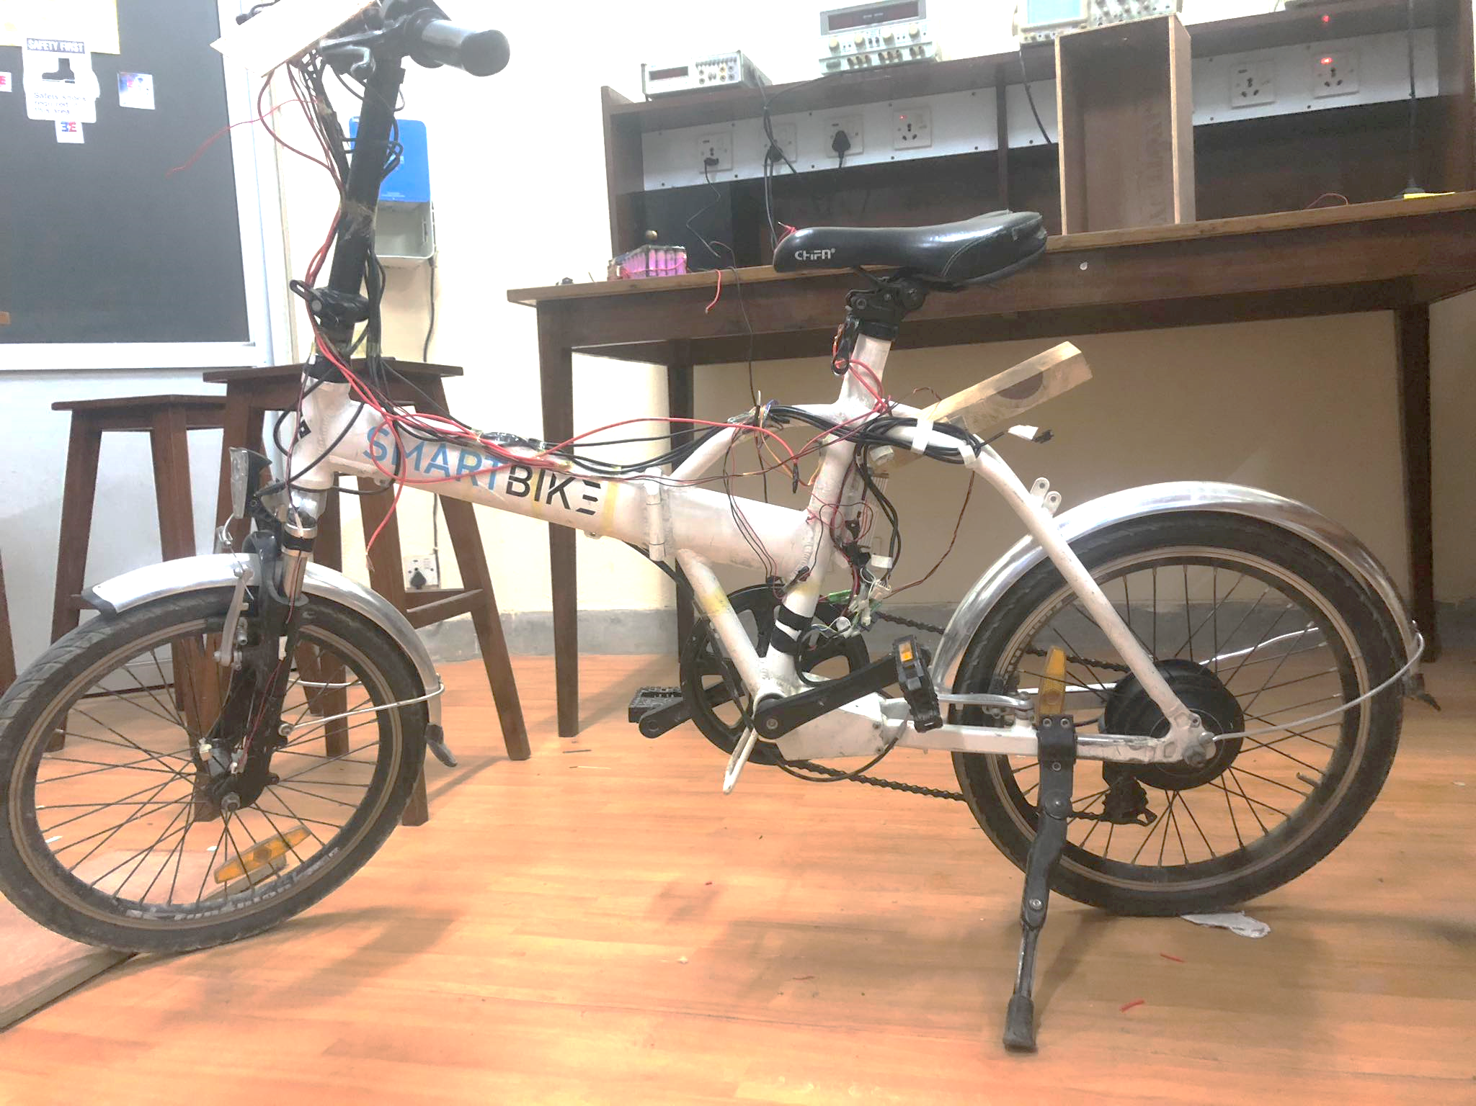
THANK YOU!!!
Satish Mahaseth, Kiran Khatri, Kushal Bhatta
Department of Electrical and Electronics Engineering 2024

